Slide 1
                Status of (the) TALYS (empire)
Arjan Koning, IAEA

Slide 2
Contents
Public relations
Level density and photon strength function validation
Eric!
Wild ideas for the future

Slide 3
This is now the basic reference
for TALYS

Slide 4
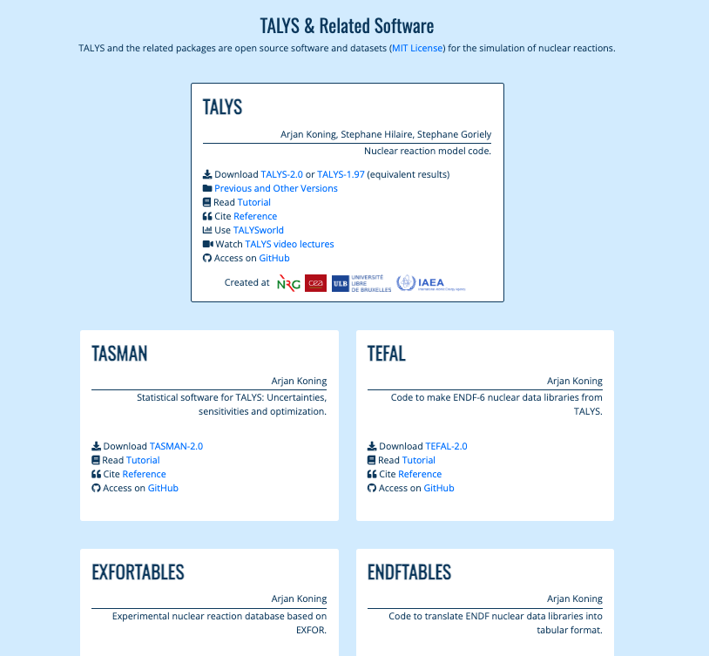
nds.iaea.org/talys

Slide 5
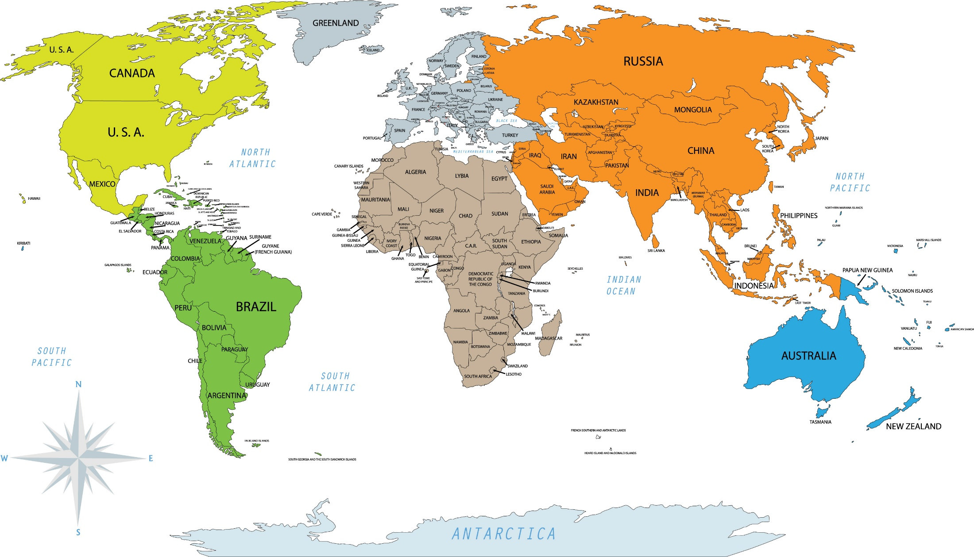
TALYS around the World (status 2022)
Around 5500 citations (web of sciences)
544
1610
828
1046
506
199
563
247
174
218
127

Slide 7
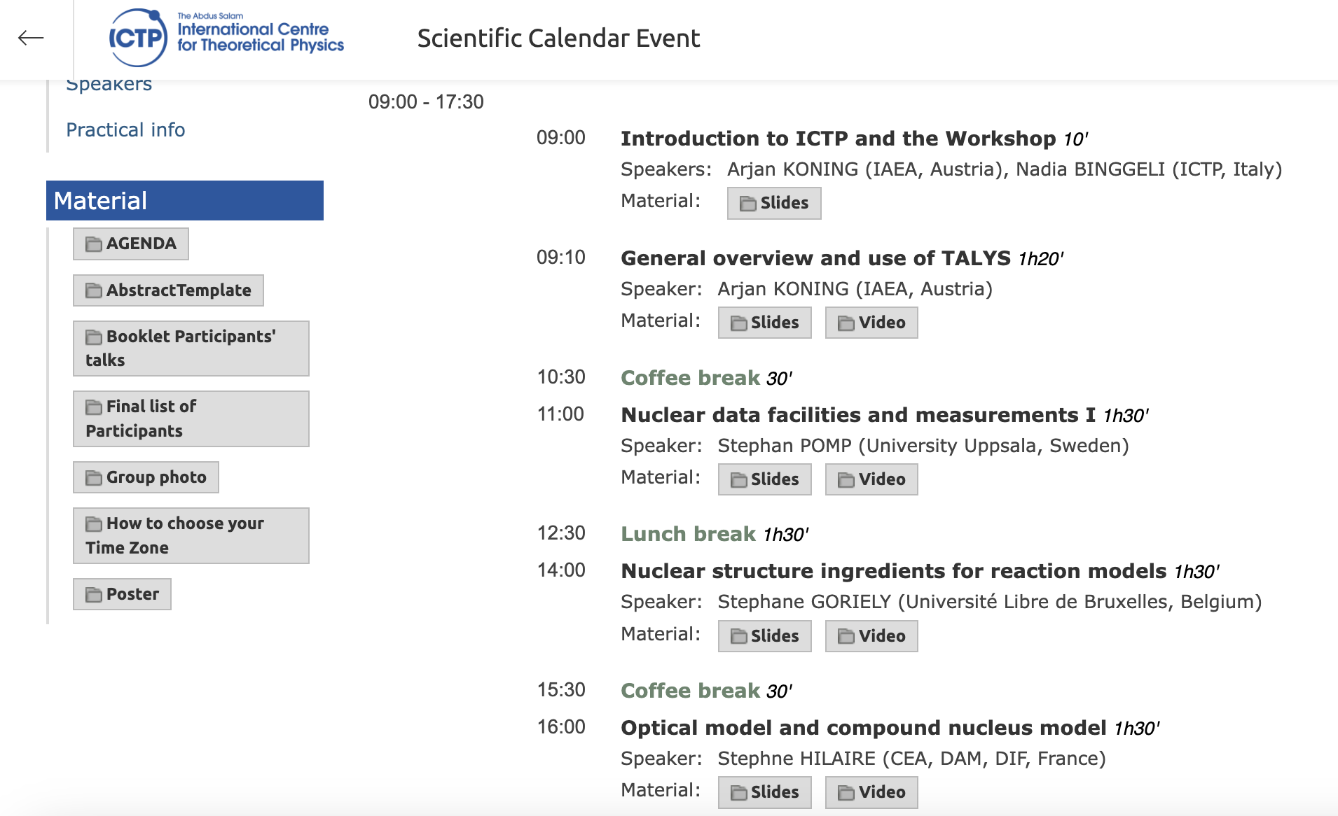
https://indico.ictp.it/event/10221/ : 30 hours of TALYS videos

Slide 8
TALYS
Input
Physical parameters
Reaction
models
Multiple
emission
Output
projectile n
element Fe
mass 56
energy 14.0
Nuclear Structure (RIPL-3)
Masses
Discrete levels
Level densities
Resonance parameters
Photon strength functions
Optical model parameters
Fission barrier parameters
Optical model (ECIS)
Local/global OMP
Phenomenological
Semi-microscopic (JLM)
Multiple emission
Hauser-Feshbach
Multiple preeq. exciton
Fission competition
γ-ray cascade
Exclusive channels
Recoils
Fission fragment de-excitation
Direct reaction
Spherical OMP
DWBA
Coupled-channels
Rotational
Vibrational
Giant resonances
Weak-coupling
Output files per reaction channel
Cross sections
Total
Exclusive: (n,γ), (n,f), (n,n’), (n,2n), (n,p) etc.
Per level
Residual production
Particle production
γ-ray production
Emission spectra
Single-differential
Double differential
Recoils
Angular distributions
Elastic
Per level
Particle multiplicities
Fission yields, neutron observables
Astrophysical reaction rates, MACS
…etc
~ 400 keywords
Other
Fission fragment distributions
‘Best’ nuclear model parameters optimised to experimental reaction data
Compound reactions
Hauser-Feshbach
Width fluctuations
Blatt-Biedenharn ang. dis.
Particle, photon and fission transmission coeff.
γ-ray emission
Phenomenological parameters
Microscopic tables
Pre-equilibrium reactions
Exciton model
Particle hole level density
Kalbach systematics
Angular distribution
Cluster emission
γ-ray emission

Slide 9
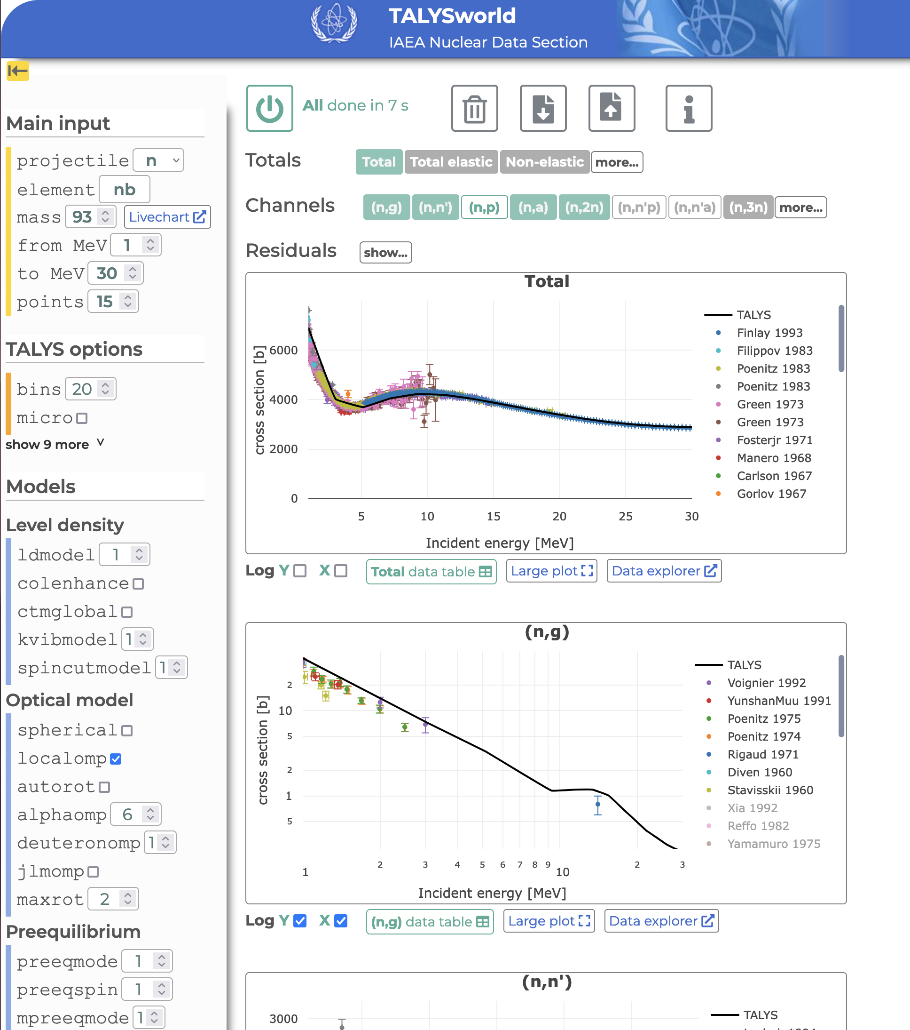

If nothing else works….TALYSworld!!!
TALYS world
https://nds.iaea.org/relnsd/talys/talys.html
Run TALYS online
Direct plots
EXFORtables included (coverage of EXFOR not complete)
Status July 2024:
  First announcement at ICTP Trieste School on TALYS
  Half of the keywords are implemented
  Only cross sections
Scan me!
IAEA Nuclear Data Section

Slide 10
TALYS-2.0
Some important new features since TALYS-1.96 (Dec 2021)
  Further refinement of explicit evaporation of fission fragments via Hauser-Feshbach: FY, nubar, nu(A), PFNS, etc. using HF3D, GEF, SPY and 4D-Langevin fission fragment distributions
  ‘fit y’: read in optimised nuclear model parameters for all nuclides and reaction channels (from TASMAN parameter search to EXFOR), giving the best fits
  Unifying all TALYS output in YANDF format (Yet Another Nuclear Data Format) for efficient interpretation for processing software - ENDF, GNDS, AI/ML, plotting, astro libraries etc. etc.
TALYS-1.97/2.0 was released end of December 2023

Slide 11
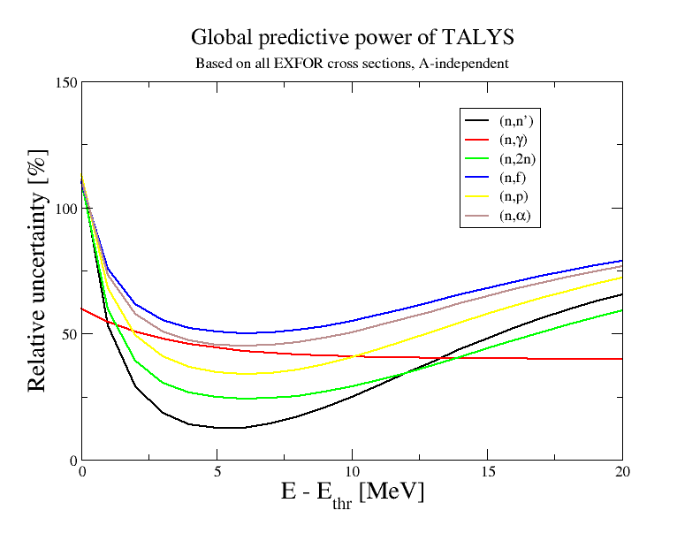
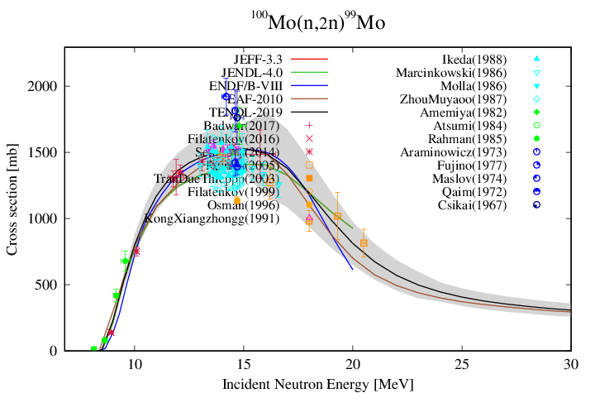
Long-term goal: Global predictive power
Ethr

Slide 12
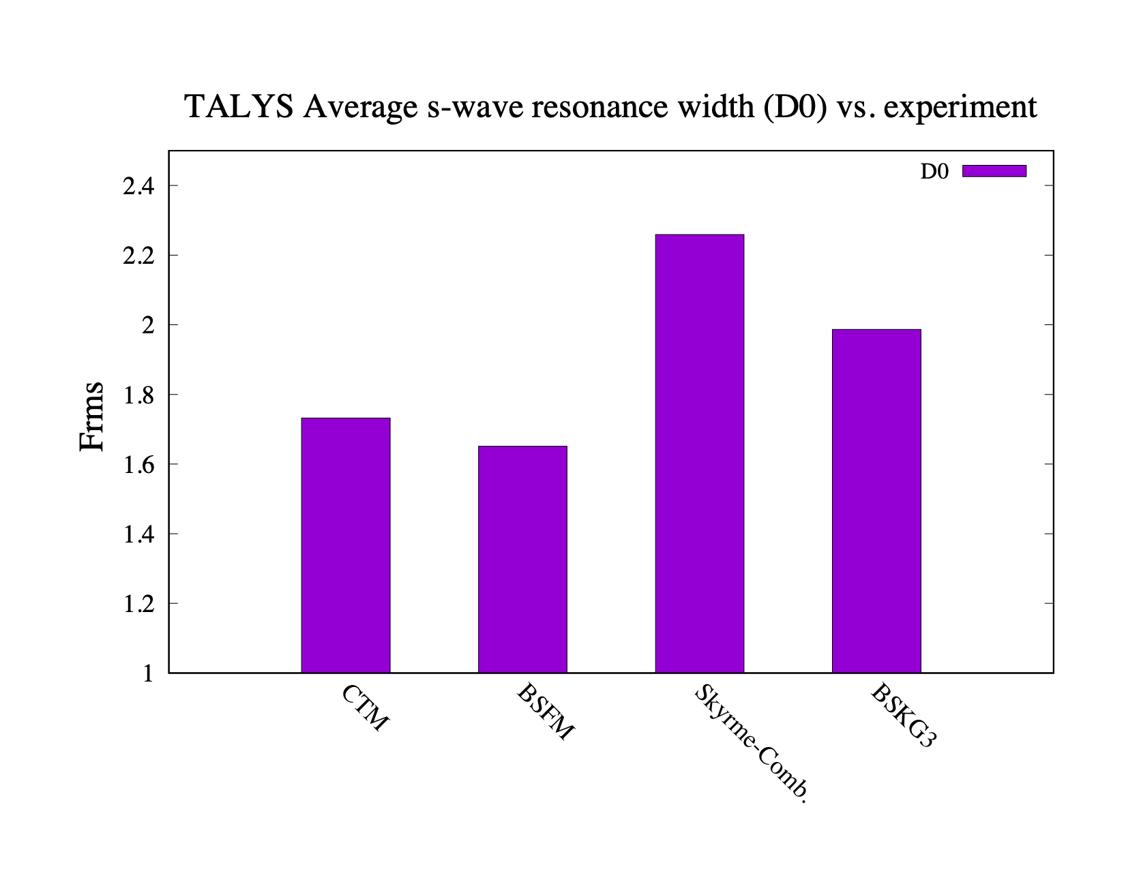
Global level densities
Nuclides with experimental D0 data: 300 (RIPL-3)

Slide 13
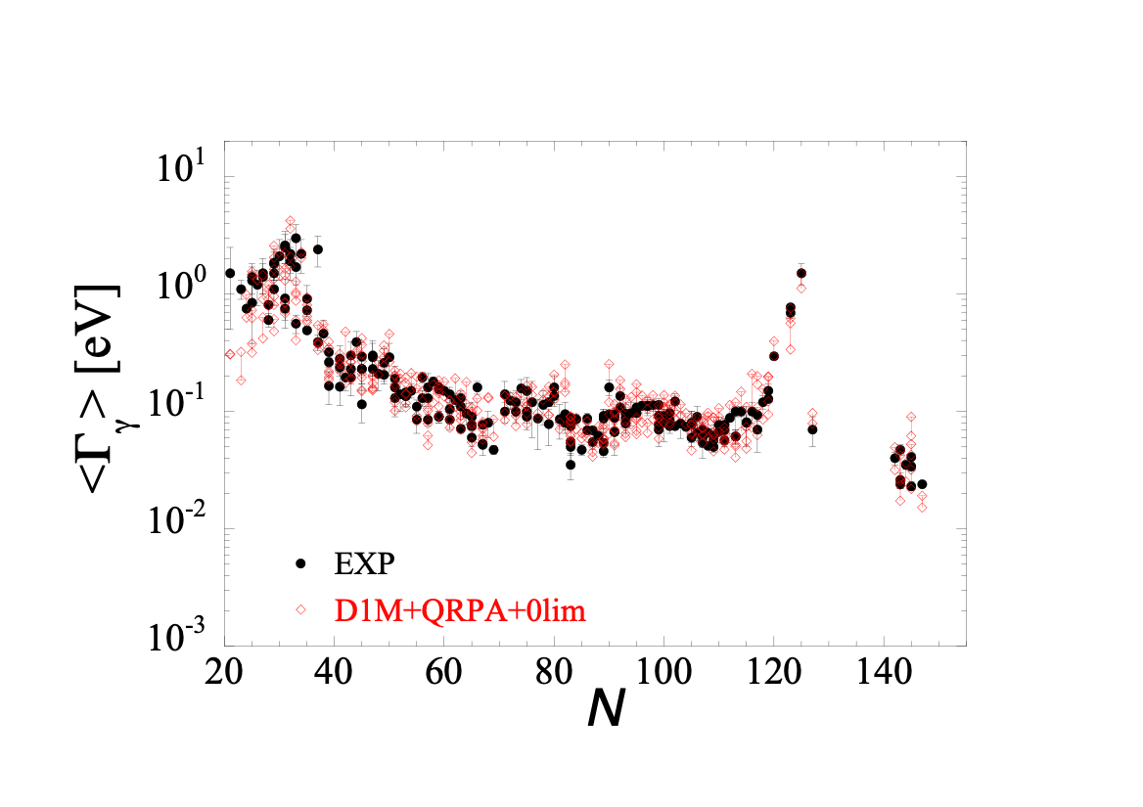
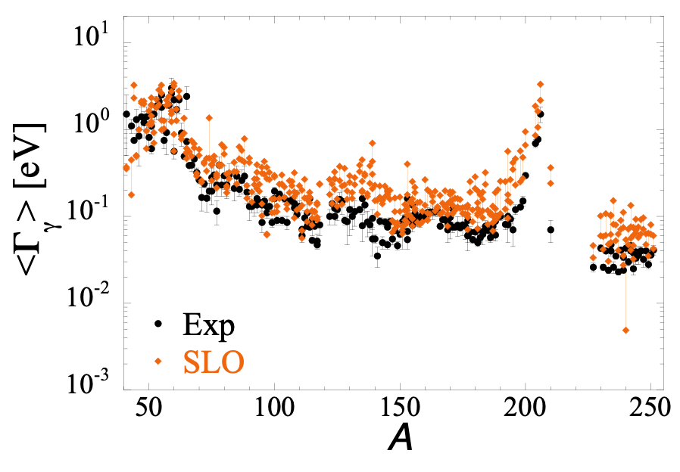
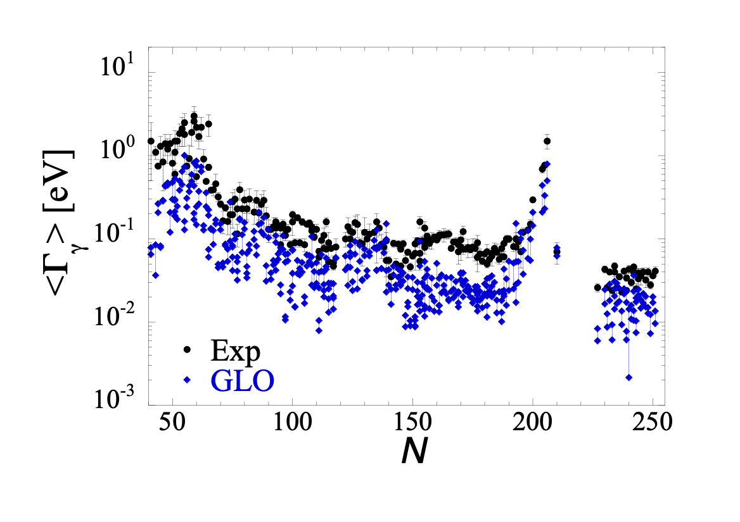
Gamma-ray strengths : Gogny QRPA vs analytical
A
10/07/2024
A
Gamma Strength Functions

Slide 14
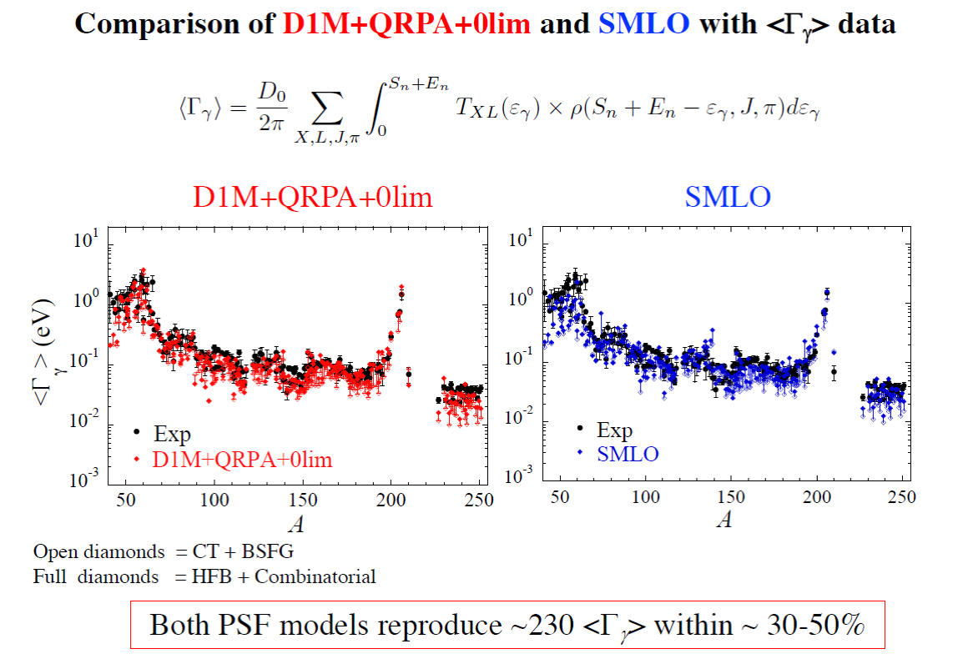
Gamma-ray strengths : Gogny QRPA vs analytical
10/07/2024
Gamma Strength Functions

Slide 15
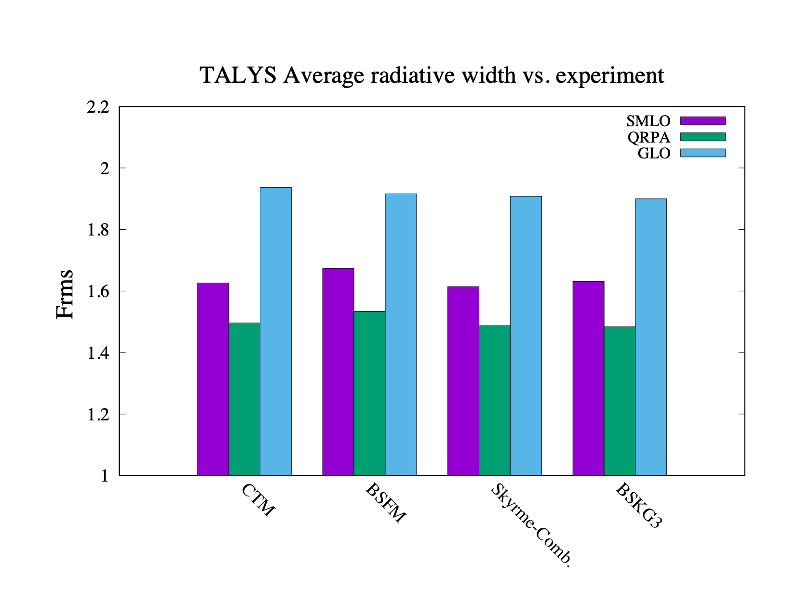
Level densities optimised to discrete levels and D0
Nuclides with experimental <Gg> data: 228

Slide 16
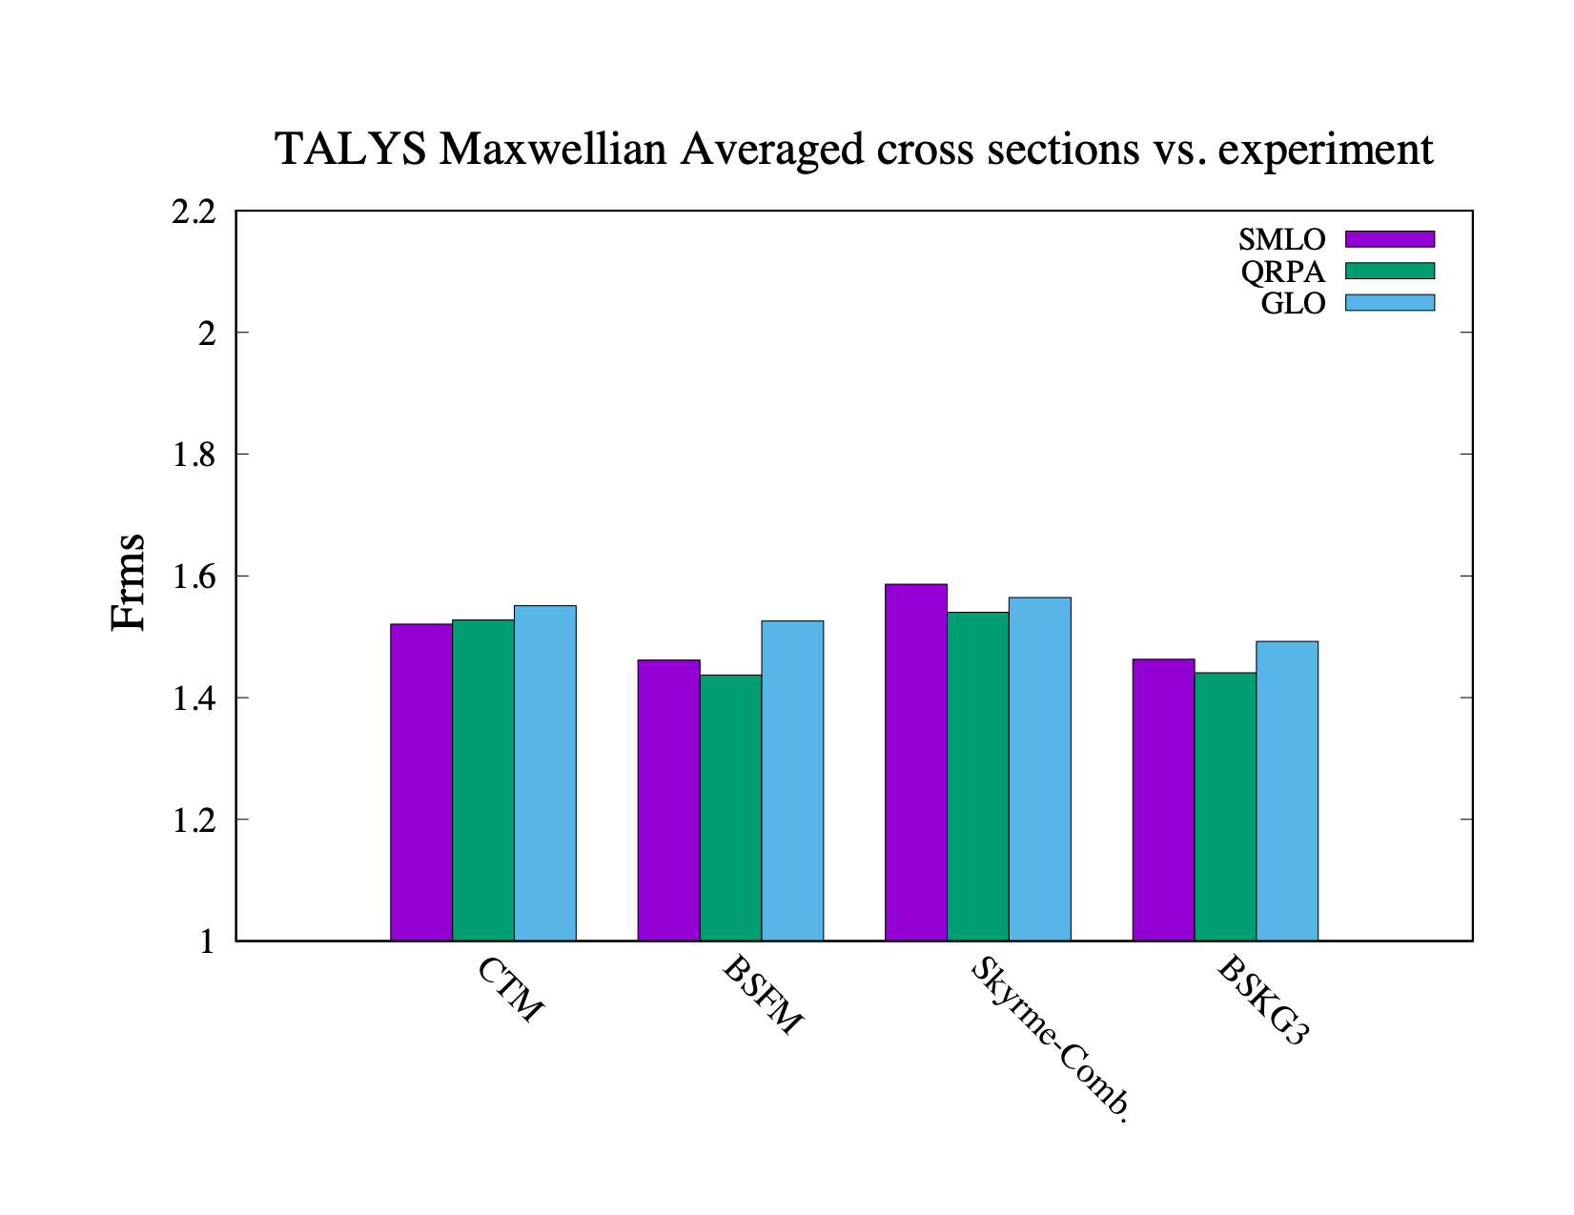
Mystery: why is GLO not
as bad as for <Gg>
Level densities optimised to discrete levels and D0
Nuclides with experimental MACS data: 277

Slide 17
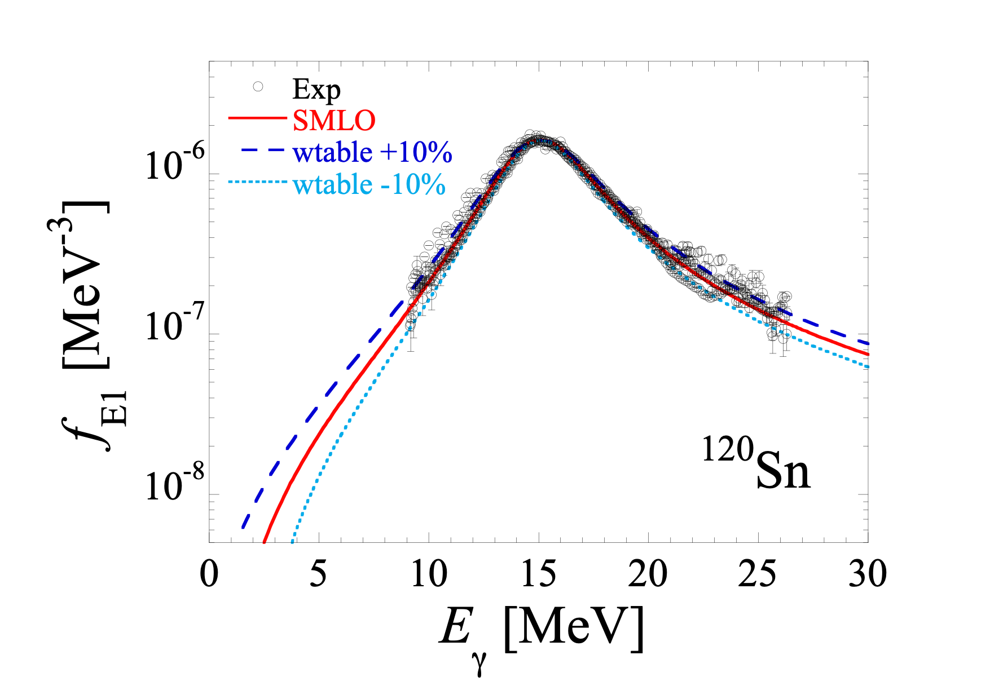
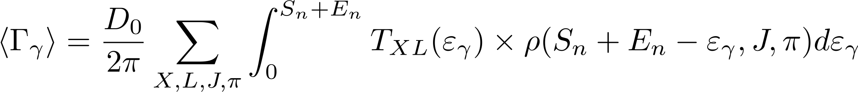
Adjusted width parameter does not affect original photon strength function very much
Sn + Ein: range
important for
(n,γ )

Slide 18
Frms : 12%

Slide 19
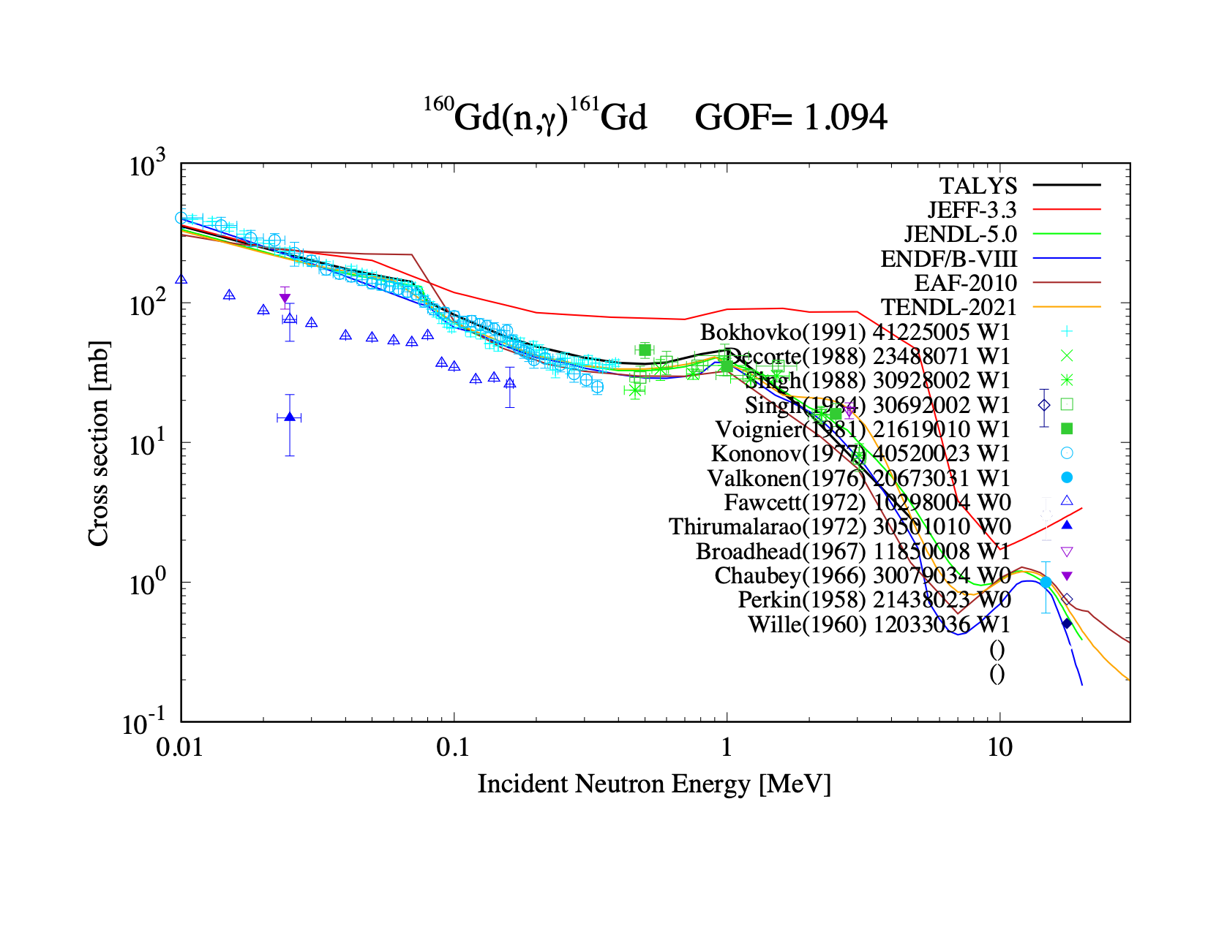
Wtable = 1.08

Slide 20
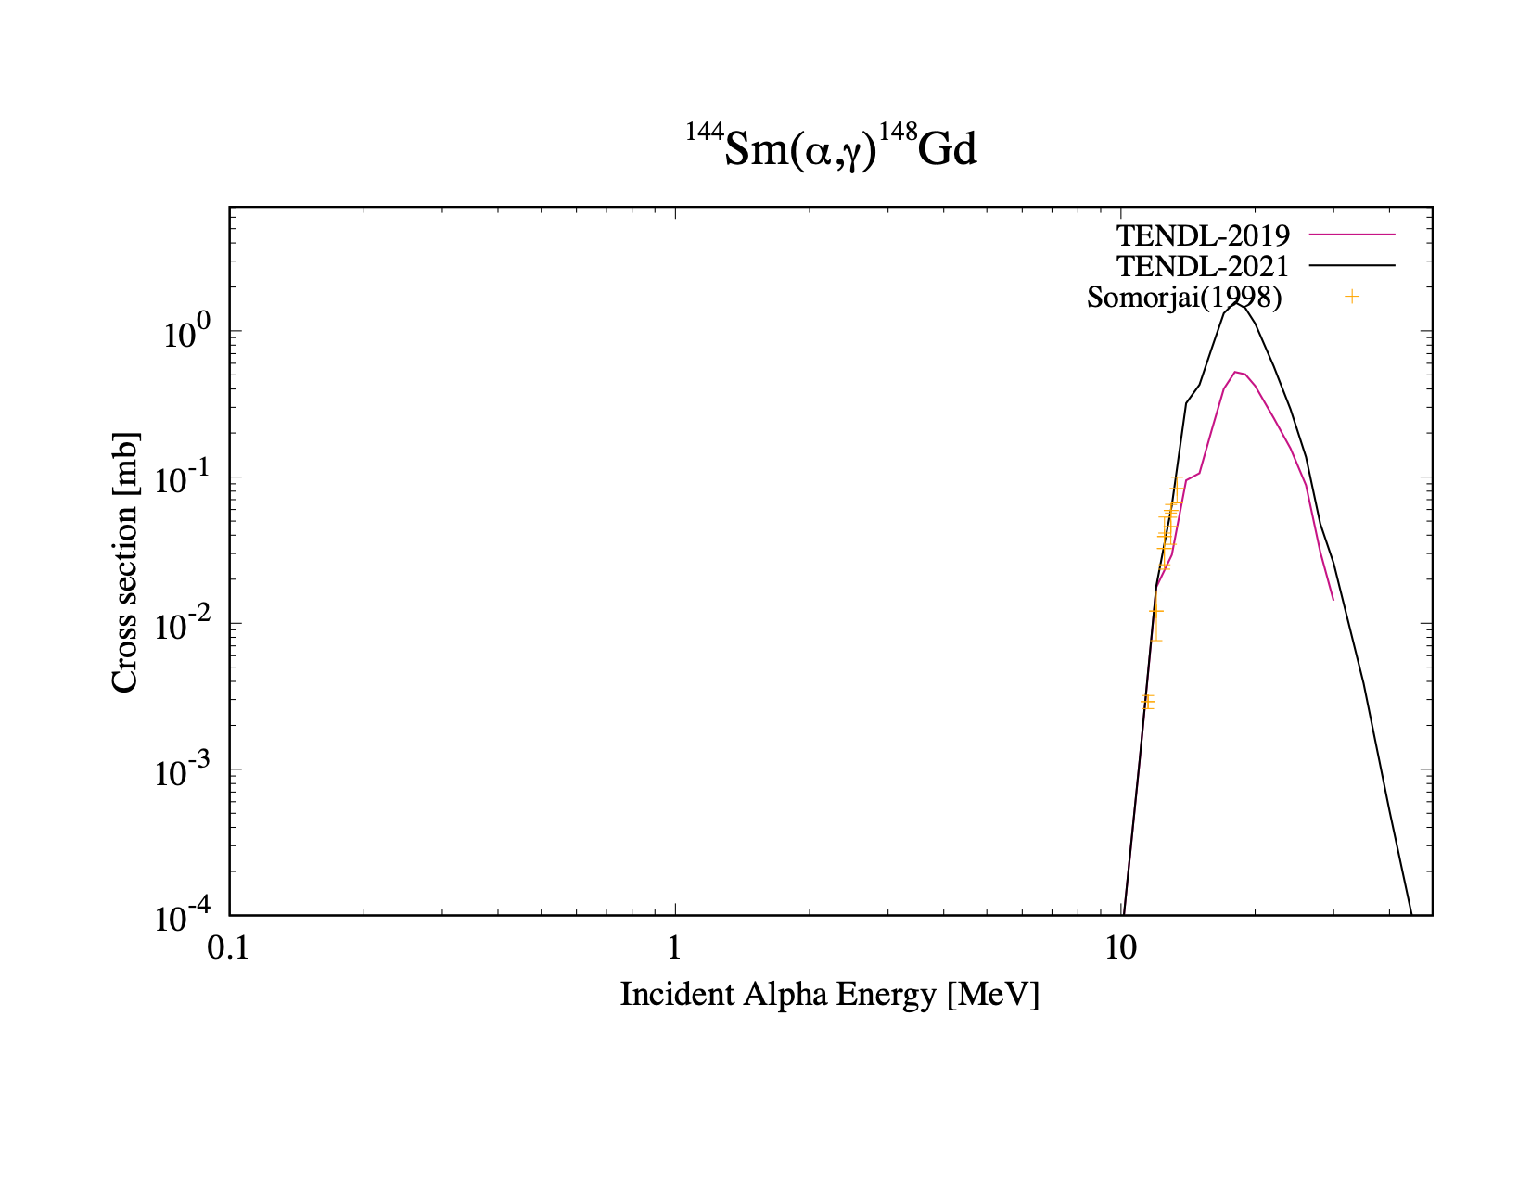
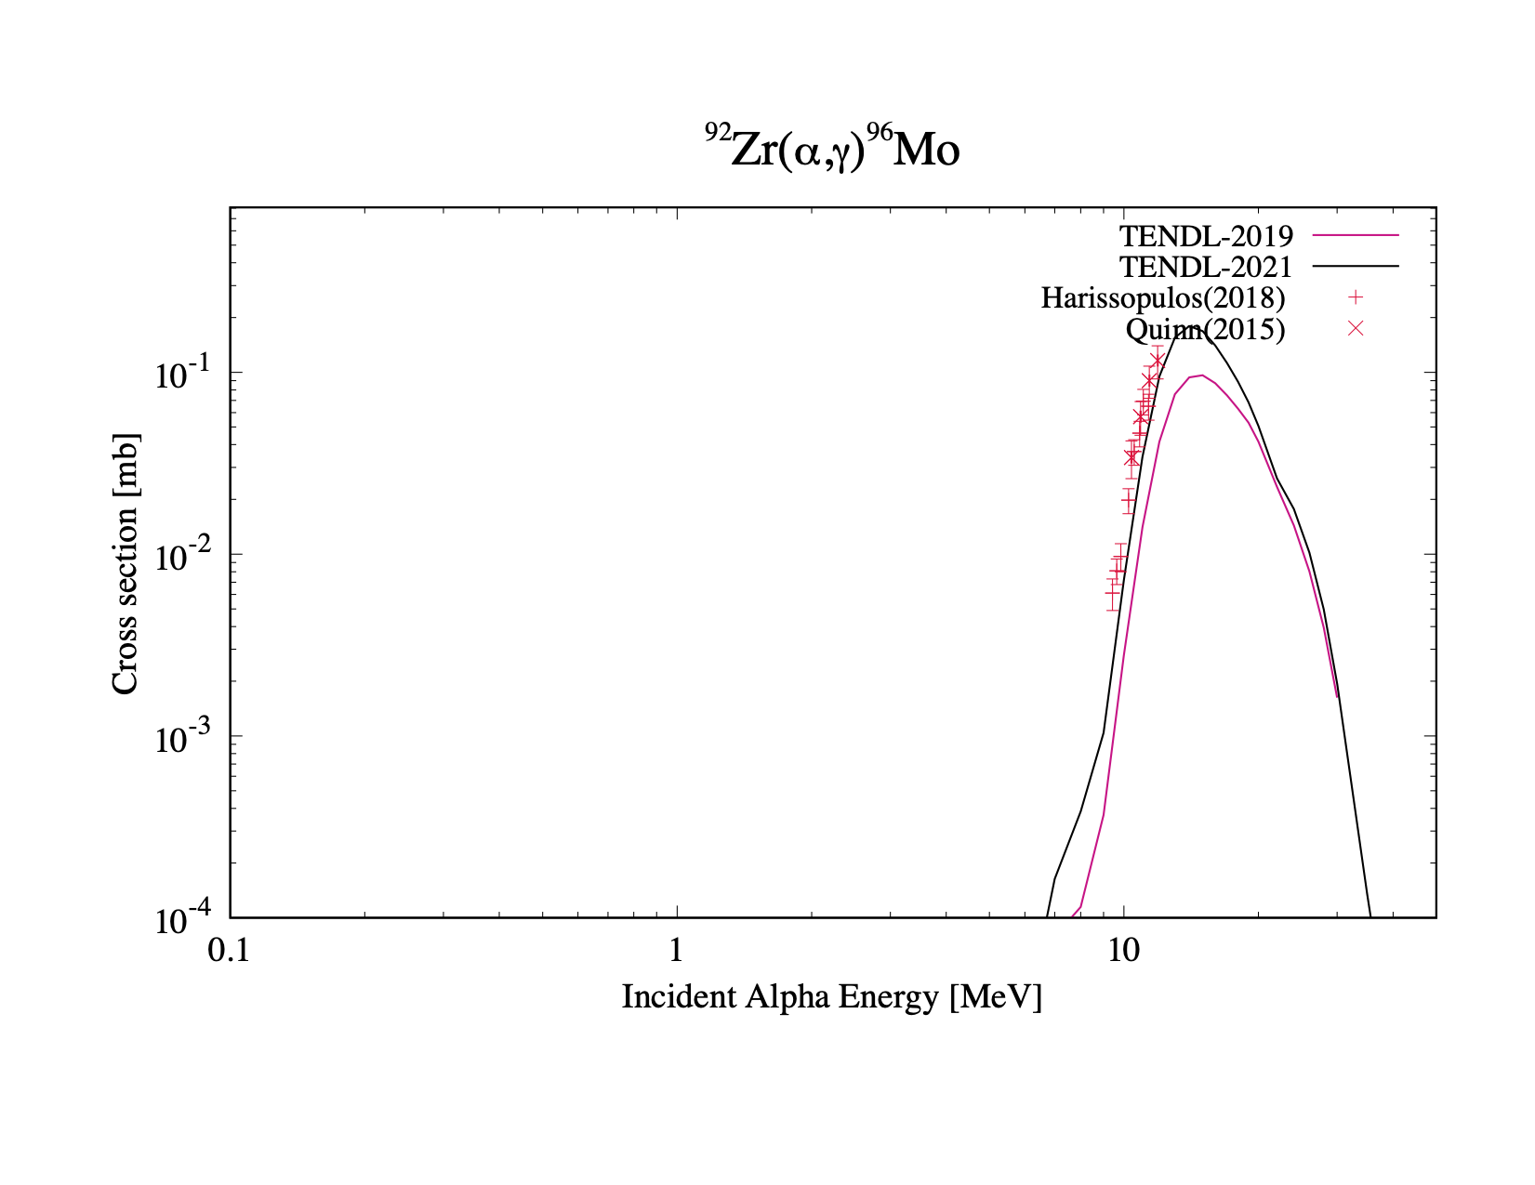
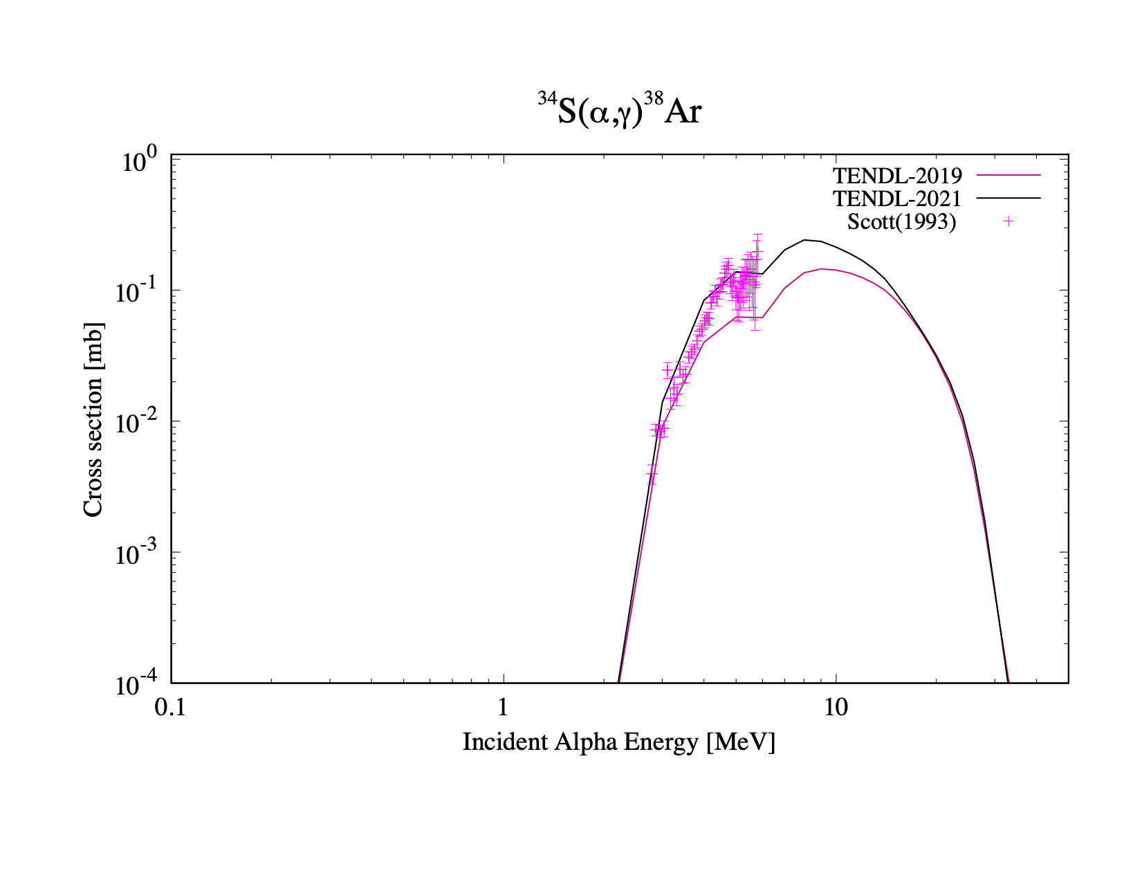
channel: (α , γ )
New photon strength functions (Plujko & Goriely), SMLO, give better gamma-related data for all reaction channels, including (α ,γ )
CRP on photon strength functions and photonuclear data, Dimitriou et al (IAEA 2019)

Slide 21
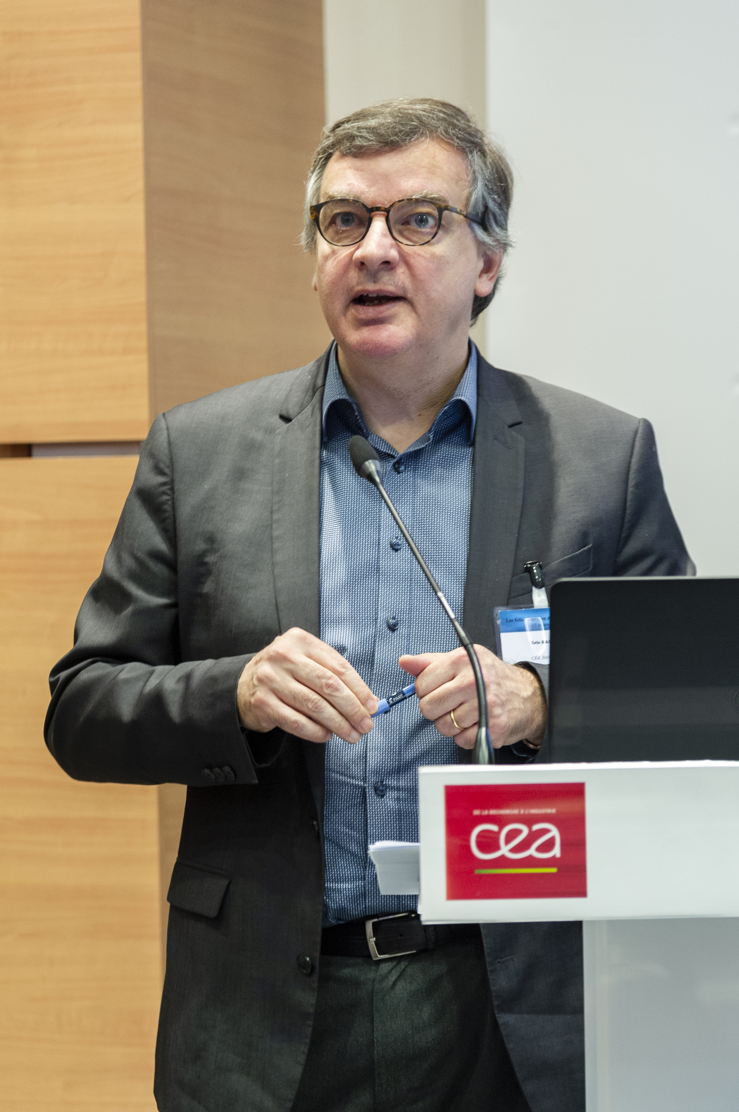
Eric Bauge JMP OMP:
Only 6 parameters
4 different input files

Slide 22
TENDL-2023: Fission yields and fission neutron observables from TALYS
TALYS: reads distribution of excited fission
fragments and evaporates them all with Hauser-Feshbach
Univ. Uppsala:
Ali Al-Adili
Fredrik Nordstroem
CEA-DAM Bruyeres:
Jean-Francois Lemaitre
Titech TOKYO:
Kazuki Fujio
Satoshi Chiba
LANL:
Toshihiko Kawano
IAEA:
Shin Okumura
Arjan Koning
(May 2022: 809 nuclides)

Slide 23
TALYS-2 only

Slide 24
TALYS output file: rp039090.L02
‘#’ for direct use in
various software, e.g.
Gnuplot
Without ‘#’: YAMLesque
2 space indentation per
level
Parsing to JSON should
be easy
Only 5 main attributes for
nuclear reactions
TALYS: 2 more main
attributes: ‘parameters’
and ‘observables’
EXFOR: All specific
metadata may follow
after the datablock

Slide 25
Future (?): Extension to 2 GeV
Challenges:
  Extension of OMP to 2 GeV
    folding/microscopic approach, wine-bottle shape
    Woods-Saxon not appropriate
  Include pions or good approximation to exclude them
Existing features:
  (Multiple) Pre-equilibrium known to work to quite high energies (Mashnik)
  TALYS has built in multiple loops over itself for residual products (as for fission fragments)
  The systematic logic of TALYS input, output and reaction flow

Slide 26
Future (?): Extension to heavy ions
Challenges:
  Extension of OMP to heavy ions
    Folding/microscopic approach, Sao Paolo potential
    Woods-Saxon maybe another option
  Much higher J-limit in TALYS (more dynamic programming)
Existing features:
  Pre-equilibrium known to work for heavy ions (Gadioli)
  Hauser-Feshbach would be applied as usual
  Probably easy extension of the arrays
  The systematic logic of TALYS input, output and reaction flow

Slide 27
Near future: Full particle decay scheme and Monte Carlo
Challenges:
  Write complete reaction flow to probability tables: Hauser-Feshbach + Direct + Pre-equilibrium
  Allows restarting with Monte Carlo scheme
  Allows direct inclusion in advanced transport codes
  Finalise “Dicebox-like” capability
Existing features:
  Basically there, since we already need it for any TALYS calculation

Slide 28
Thank you!
Notes:
Thank you!

